Slide 1


MINI PROJECT ON
Attainment calculating software
By
Sahil Shaikh
Suryoday Kumar
Zeeshan Shaikh
Hrutik Parbalkar
under the guidance of
Mrs. Ekta Ukey
Department of Computer Engineering
Pillai HOC College of Engineering and Technology, Rasayani
University of Mumbai, Mumbai
A.Y. 2023-24

Slide 2


CONTENTS
1. Introduction
2. Literature review
3. Limitations of existing system
4. Problem Definition
5. System Architecture
6. Results
7. Conclusion
8. References

Slide 3


INTRODUCTION
Student Attainment Calculation Software is a cutting edge tool that simplifies the assessment of student performance in educational institutions.
With advanced data analysis and user-friendly features, it empowers educators to make informed decisions, enhance academic outcomes, and promote excellence in education.

Slide 4

LITERATURE REVIEW
User Friendly Interface
Excel sheet access
Usability and Flexibility
Customization Options

Slide 5
LIMITATIONS OF EXISTING SYSTEM
Limited Usability
Inflexibility in Data Integration
Ineffective in Diverse Educational Settings
Inefficiency in Data Analysis

Slide 6
PROBLEM DEFINITION
Lack of Flexibility and Adaptability
Challenges in Analyzing Learning Outcomes
Difficulty in Data Integration

Slide 7
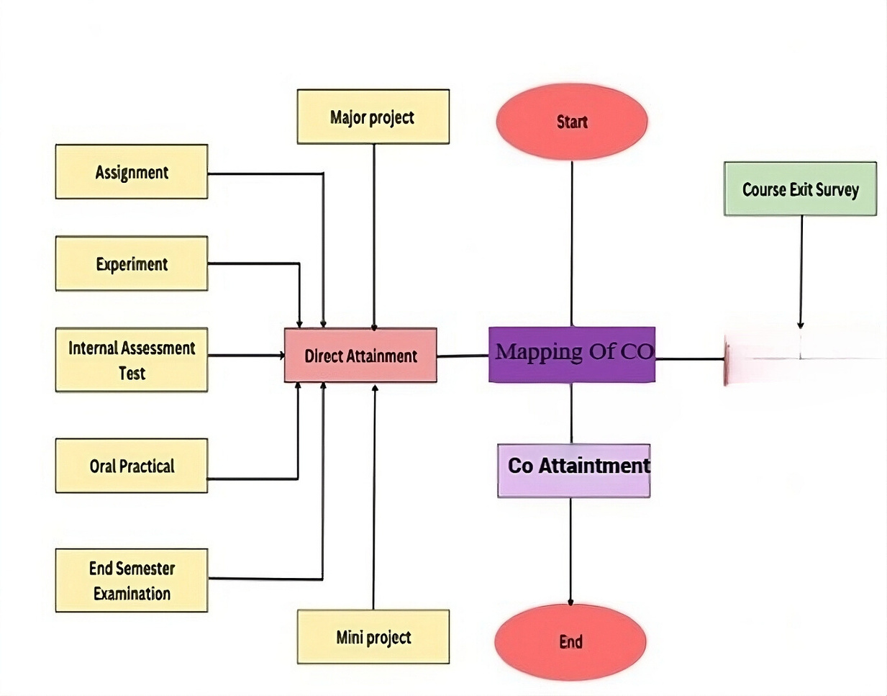
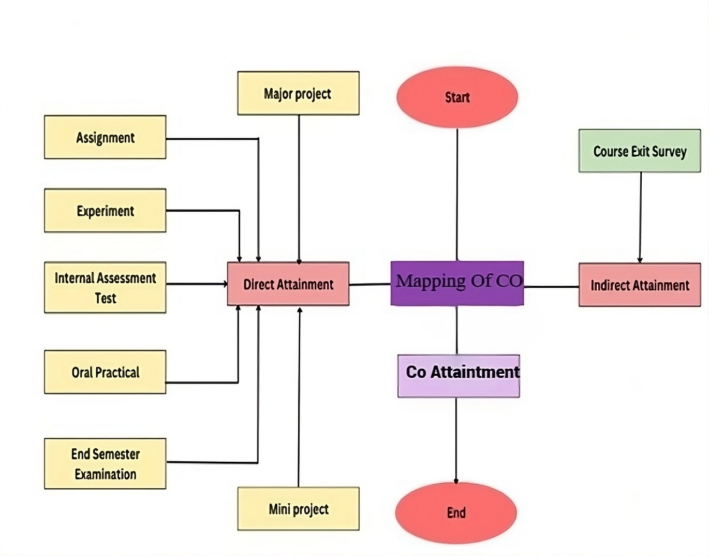
SYSTEM ARCHITECTURE

Slide 8
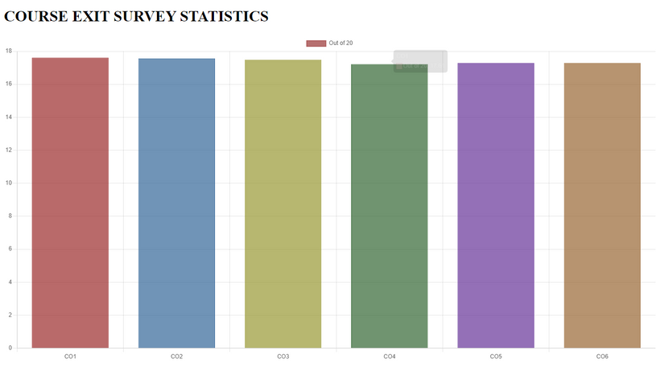
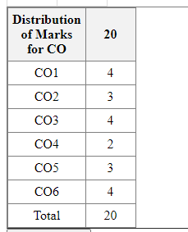
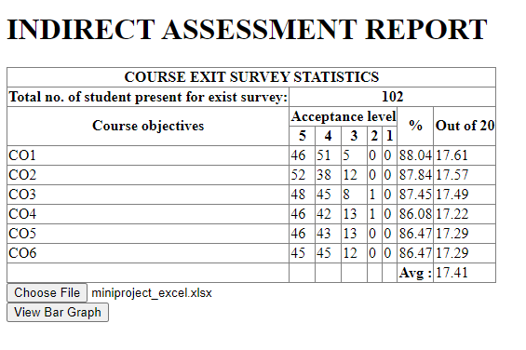
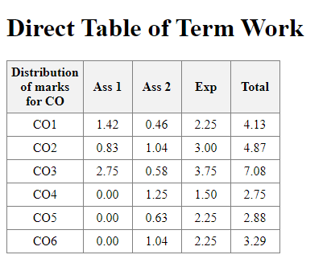
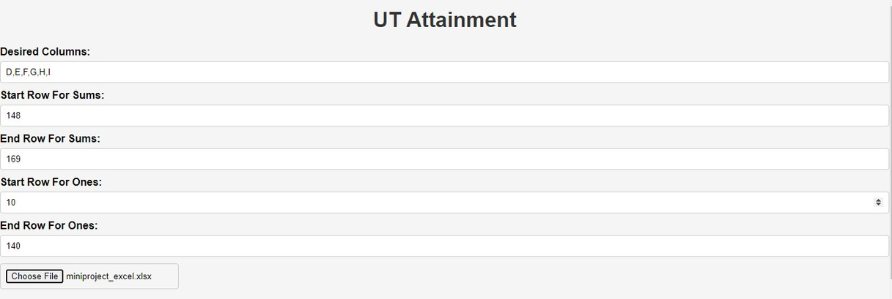
RESULTS

Slide 9
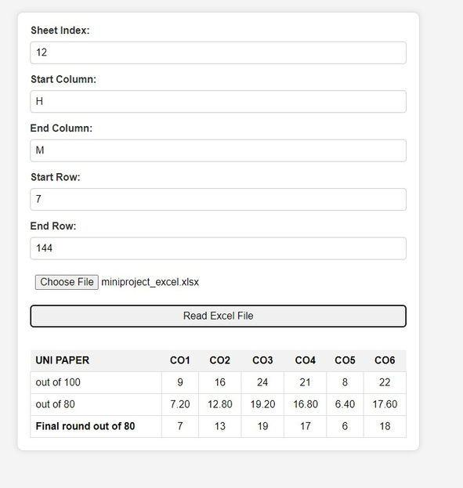
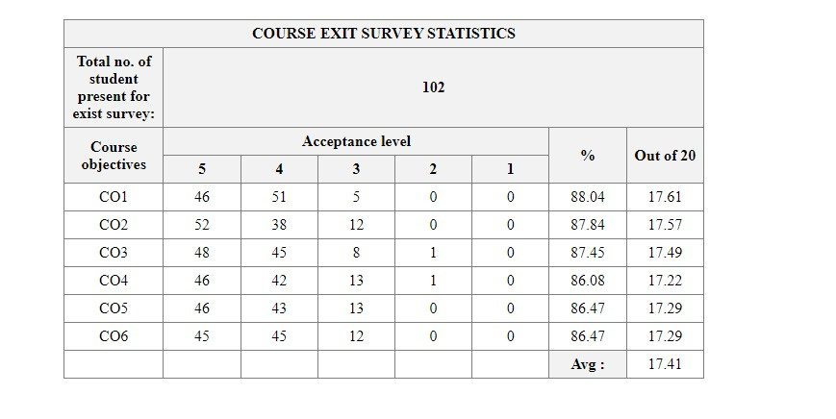
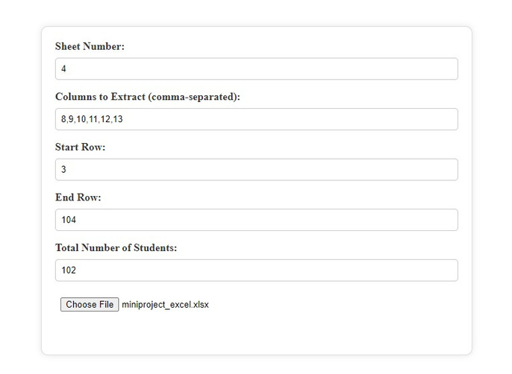
RESULTS

Slide 10
CONCLUSION
The enhanced college attainment calculator has the potential to significantly improve the accuracy and efficiency of assessing learning outcomes, ultimately leading to better educational experiences and outcomes for students.

Slide 11
REFERENCES
Akash Rajak, Ajay Kumar Shrivastava, Divya Prakash Shrivastava, "Automating Outcome Based Education for the Attainment of Course and Program Outcomes,” IEEE, 2022.
Mousami Vanjale, Member, IEEE, Sachin Shelar, Member, IEEE, Dr. P. B. Mane, "Assessment of Course Outcomes (COs) in University Affiliated Engineering Programs," IEEE, 2023.

Slide 12



Thank You

